Slide 1

BitClass
LIVE Learning Platform
Saloni Jain

Slide 2
About BitClass
Live Learning Virtual Platform
Cohort based Education
Marketing, Software and Capital for teachers
2 way interactive sessions
Free workshops
Try and Buy experience
About the Teardown
User Activation ⚡ - Given the FREE LIVE classes & recorded properties present on the app, design a user journey to "activate" all the new users within the first 7 days of signing-up on the app

Slide 3

Global E-learning Market
Market overview
The Global Digital Education Market size is about to grow from USD 11.5 billion in 2021 to USD 46.7 billion by 2026, at a Compound Annual Growth Rate (CAGR) of 32.3%
Market trends
Reskilling and online certifications is the largest category today
Primary and secondary supplemental education will be the largest category by 2023, growing at a CAGR of 63%
Test preparation is the fastest growing category in 2021, growing at a CAGR of 64%
Immense opportunity for Game-based learning and Micro-learning
Key takeaways
Reskilling and online certifications, Primary and secondary supplemental education and Test preparation should be the focused categories on an e-learning application as most of the users who are signing up may belong to one of these categories

Slide 4

User journey >>

Slide 5

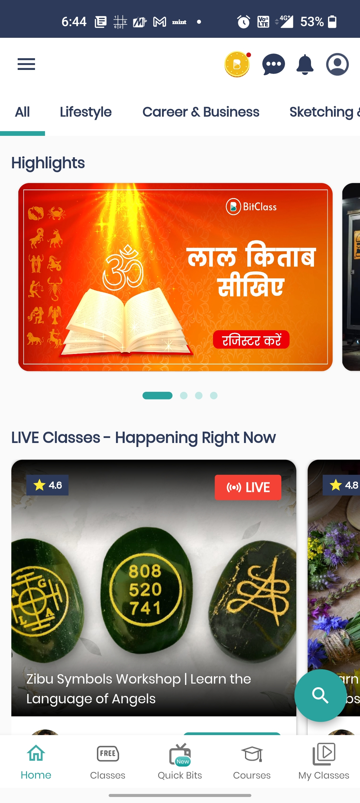
On a Sunday afternoon, Lisa wanted to learn the recipe of Cookies. She got to know about new application- BitClass. She decided to check the application. After sign-in (which was just a 15 seconds task and includes sign-in “with Goggle” option also; that she really liked) she landed to
After the application opened, she expected for relevant recommendation's basis on her interest but, No Problem, she on her own searched for Cookies.
And she was pointed to

Slide 6
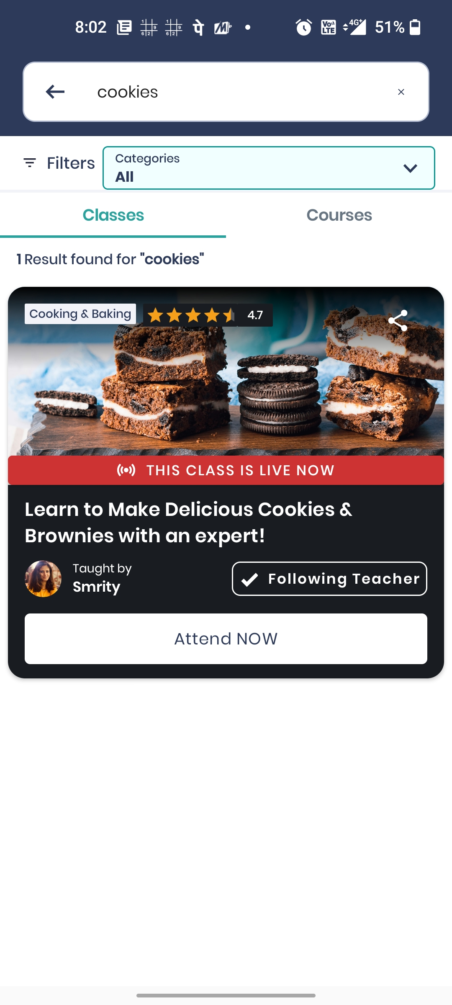
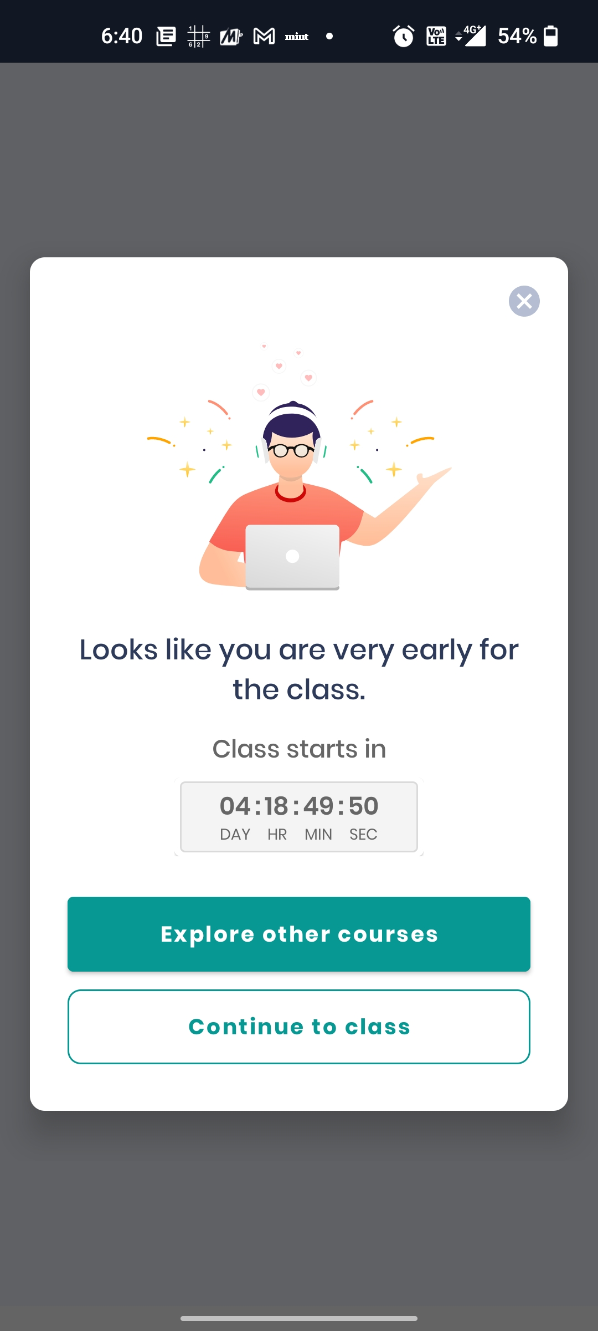
From “THIS CLASS IS LIVE NOW”, she thought that the class is running now. She excitedly clicked on “Attend Now” button and this appeared
She felt a bit disappointed and clicked on “Explore other courses” button. She got redirected to

Slide 7

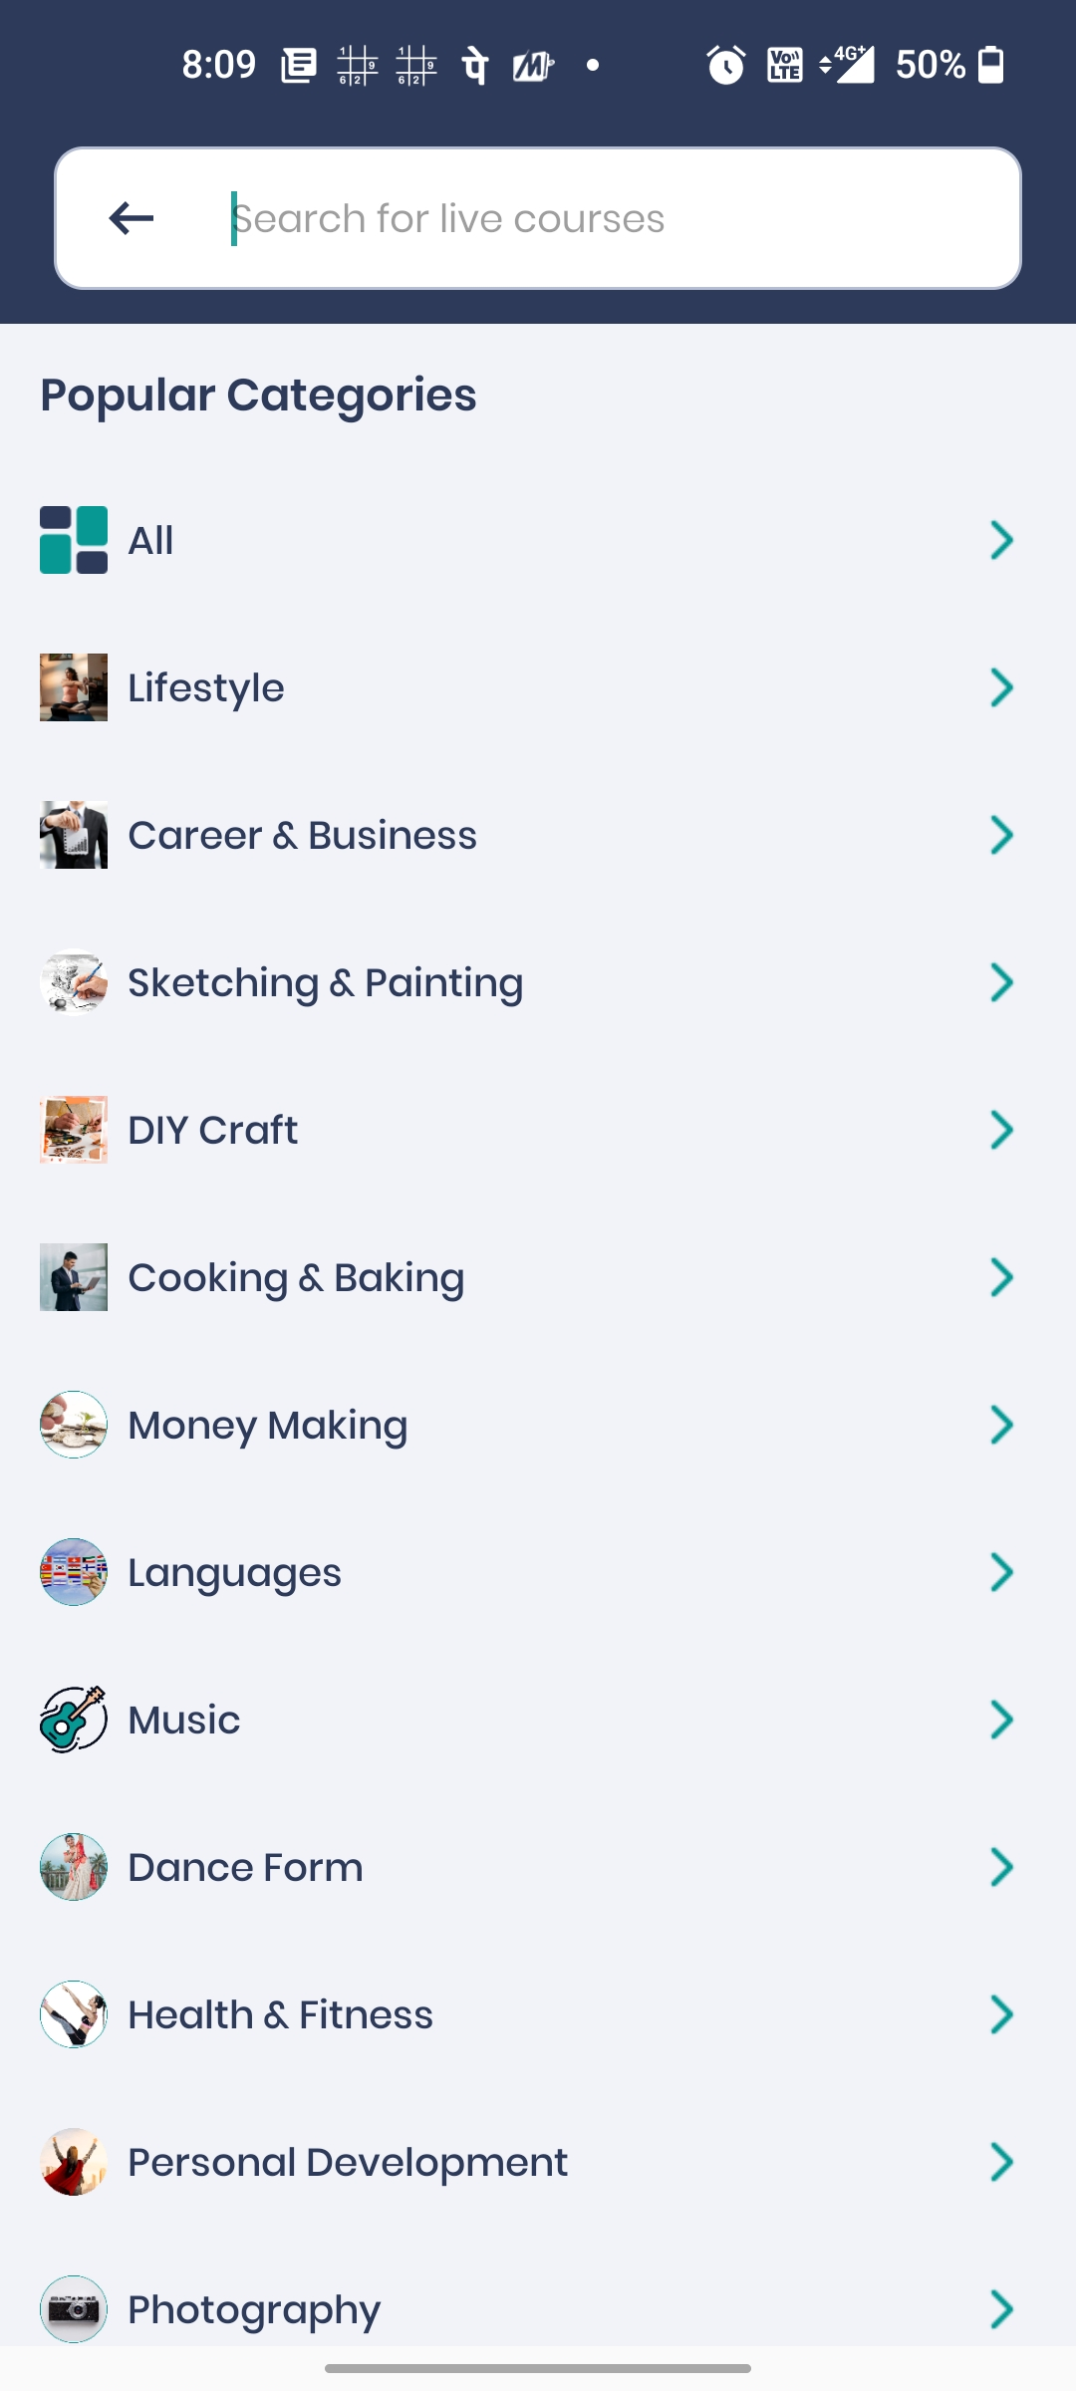
She said to one of her friends that if recommendations basis on her previous search would have come, she would be more happy and then she closed the application

Slide 8

User Personas >>

Slide 9

Tanya Shroff
Personality
Motivations
Extrovert
Ease of use
Quick Learner
Price
Technology Savvy
Discussion Forum
Goals
Pain Points
Online test preparation
Learn programming languages
Compete to win prizes
No forum for relative grading
No platform for after-class discussion
Feels difficult to stay at one thing for a longer time
Age: 18 years
Occupation: High-School student
Location: Mumbai, Maharashtra

Slide 10
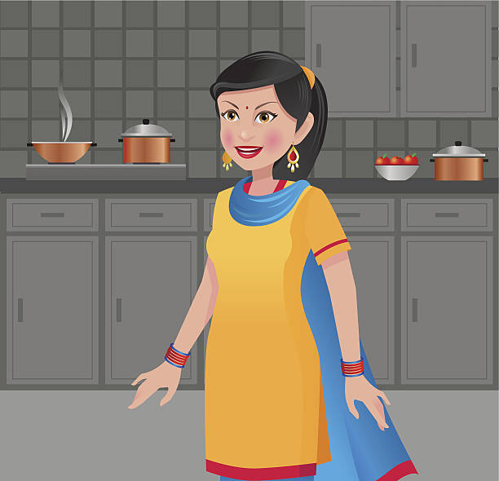
Venita Agrawal
Personality
Motivations
Extrovert
Ease of use
Quick Learner
Price
Technology Savvy
Discussion Forum
Goals
Pain Points
Casual Learning
Social skill development
To help kids with their homework
Get recognition
No in-app messaging to use the application
No recommendations of her choice
Is over-whelmed with the interface
Age: 42 years
Occupation: House wife
Location: Ujjain, Madhya Pradesh

Slide 11

Kunal Gupta
Personality
Motivations
Extrovert
Ease of use
Quick Learner
Price
Technology Savvy
Discussion Forum
Goals
Pain Points
Reskilling
Online certification courses
Social development
No Discussion Forum after attending a class in order to learn from the peers or put your queries
Age: 34 years
Occupation: MNC Office Employee
Location: Bangalore, Karnataka

Slide 12
Pain Points >>

Slide 13
Pain Points
Is overwhelmed by the interface -> Unable to raise queries and find answers immediately
Feels difficult to stay at one thing for a longer time
No recommendations of one’s choice
No Discussion Forum
Opportunities
Online Assistant can be helpful
Can provide Incentives to learn
Interest can be known
LIVE Discussion Forum can be introduced

Slide 14

Solutions >>

Slide 15
Solutions
1 | In-application Chatbot
2 | Incentive based learning
3 | Provide Market relevant content – As per Market research, 3 most trending categories on a learning application are: Reskilling and Online certifications, School Education Content and Test Preparation. So, the default recommendations can be related to these categories
4 | ‘What’s your interest’ popup
5 | ‘Explore More’ popup
6 | LIVE Discussion Forums
7 | ‘Why are you going?’ popup. Know the reason and send personalize push e-mail notification

Slide 16



In-app Chatbot
Description
Simulate conversation with users
Automated virtual assistant, capable of communicating with people through text messages
Hi, I am Sameera
I am your assistant. Please tell me how can I help you?
Benefits
Offer a smoother customer journey
Facilitate seamless live communication

Slide 17
Incentive Based Learning
Description
Earn your first 50 credits after watching your first video. If you will earn 500 credits, you can watch a video of your choice FREE
Credits can be awarded based on the number of videos watched. E.g., 5 credits for video less than 10 mins, 10 for 10-30 mins, 20 for more than 30 mins
Earn your first 50 credits
&
Get a chance to watch a video of your choice FREE
Explore Courses
Benefits
Improve the user-activation
Will make the new users attend one LIVE class for more than 10 minutes or spend 15 minutes watching recordings of past classes

Slide 18
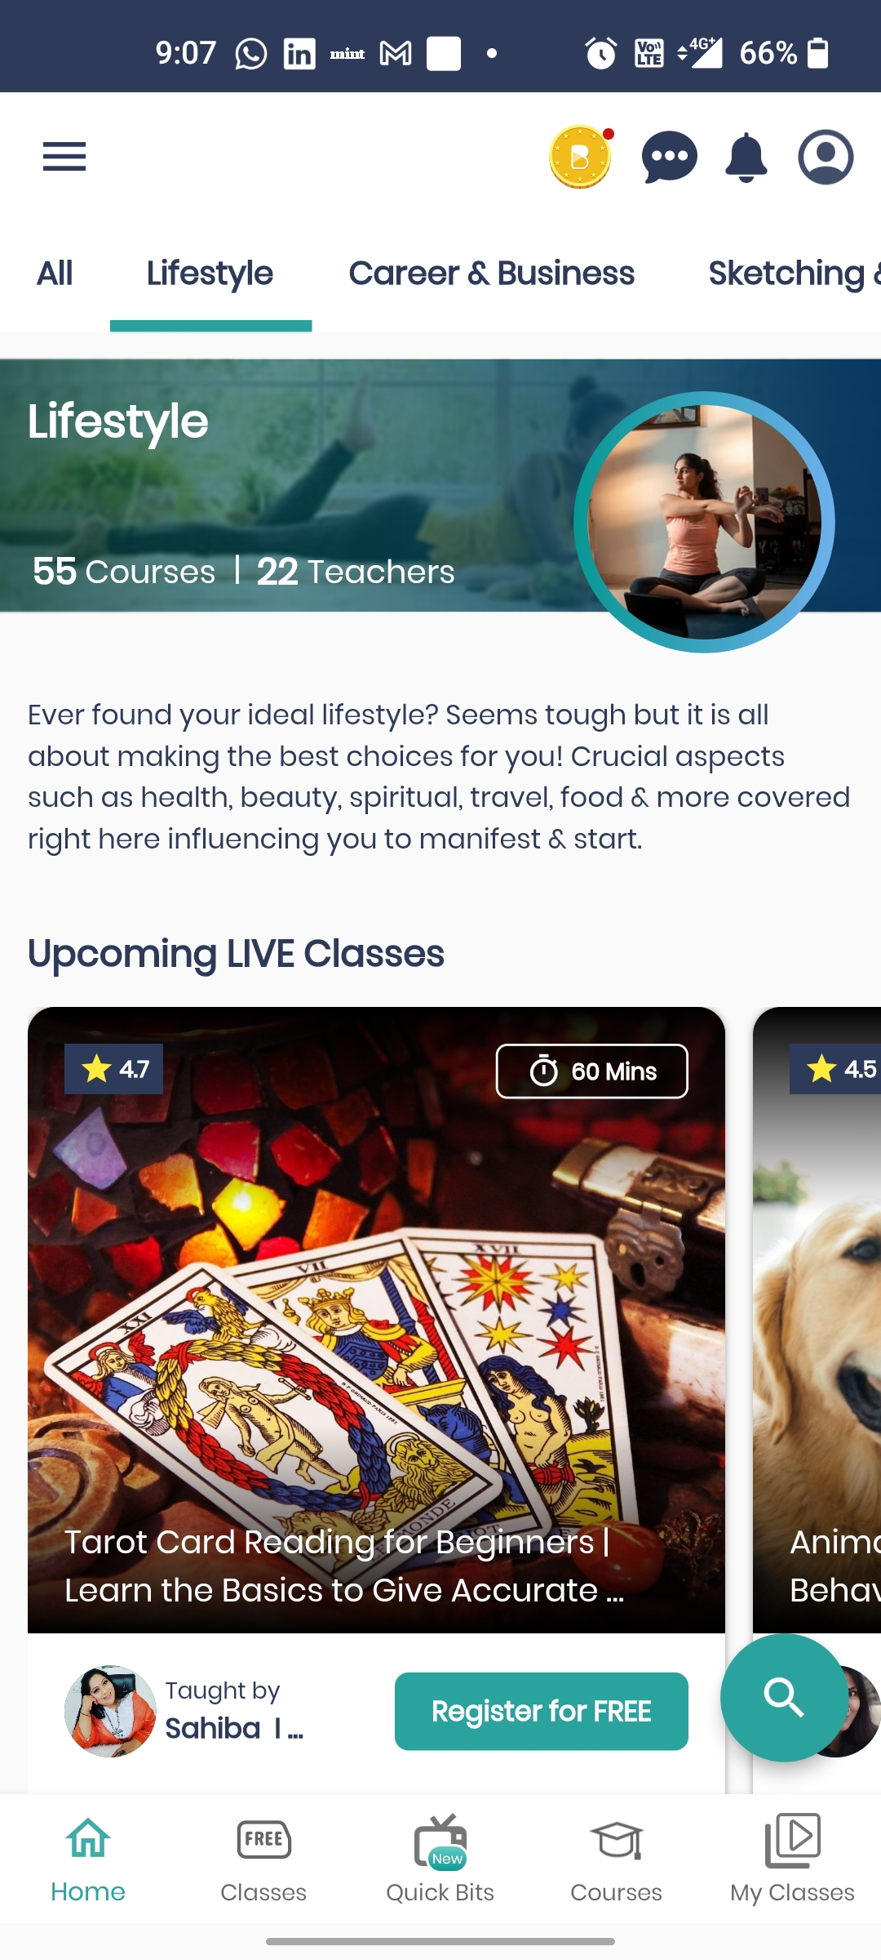

What’s your interest?
Description
When a user is opening the application for the first time, a popup message will appear to know the interest of the user
According to the reply, user can be directed to the courses of his/her choice
Please tell us about your interest
Technology
Lifestyle
Dancing
Benefits
Improve the user-activation
User will get free from the unnecessary hassle of searching the courses
Can be used to send push email notifications

Slide 19
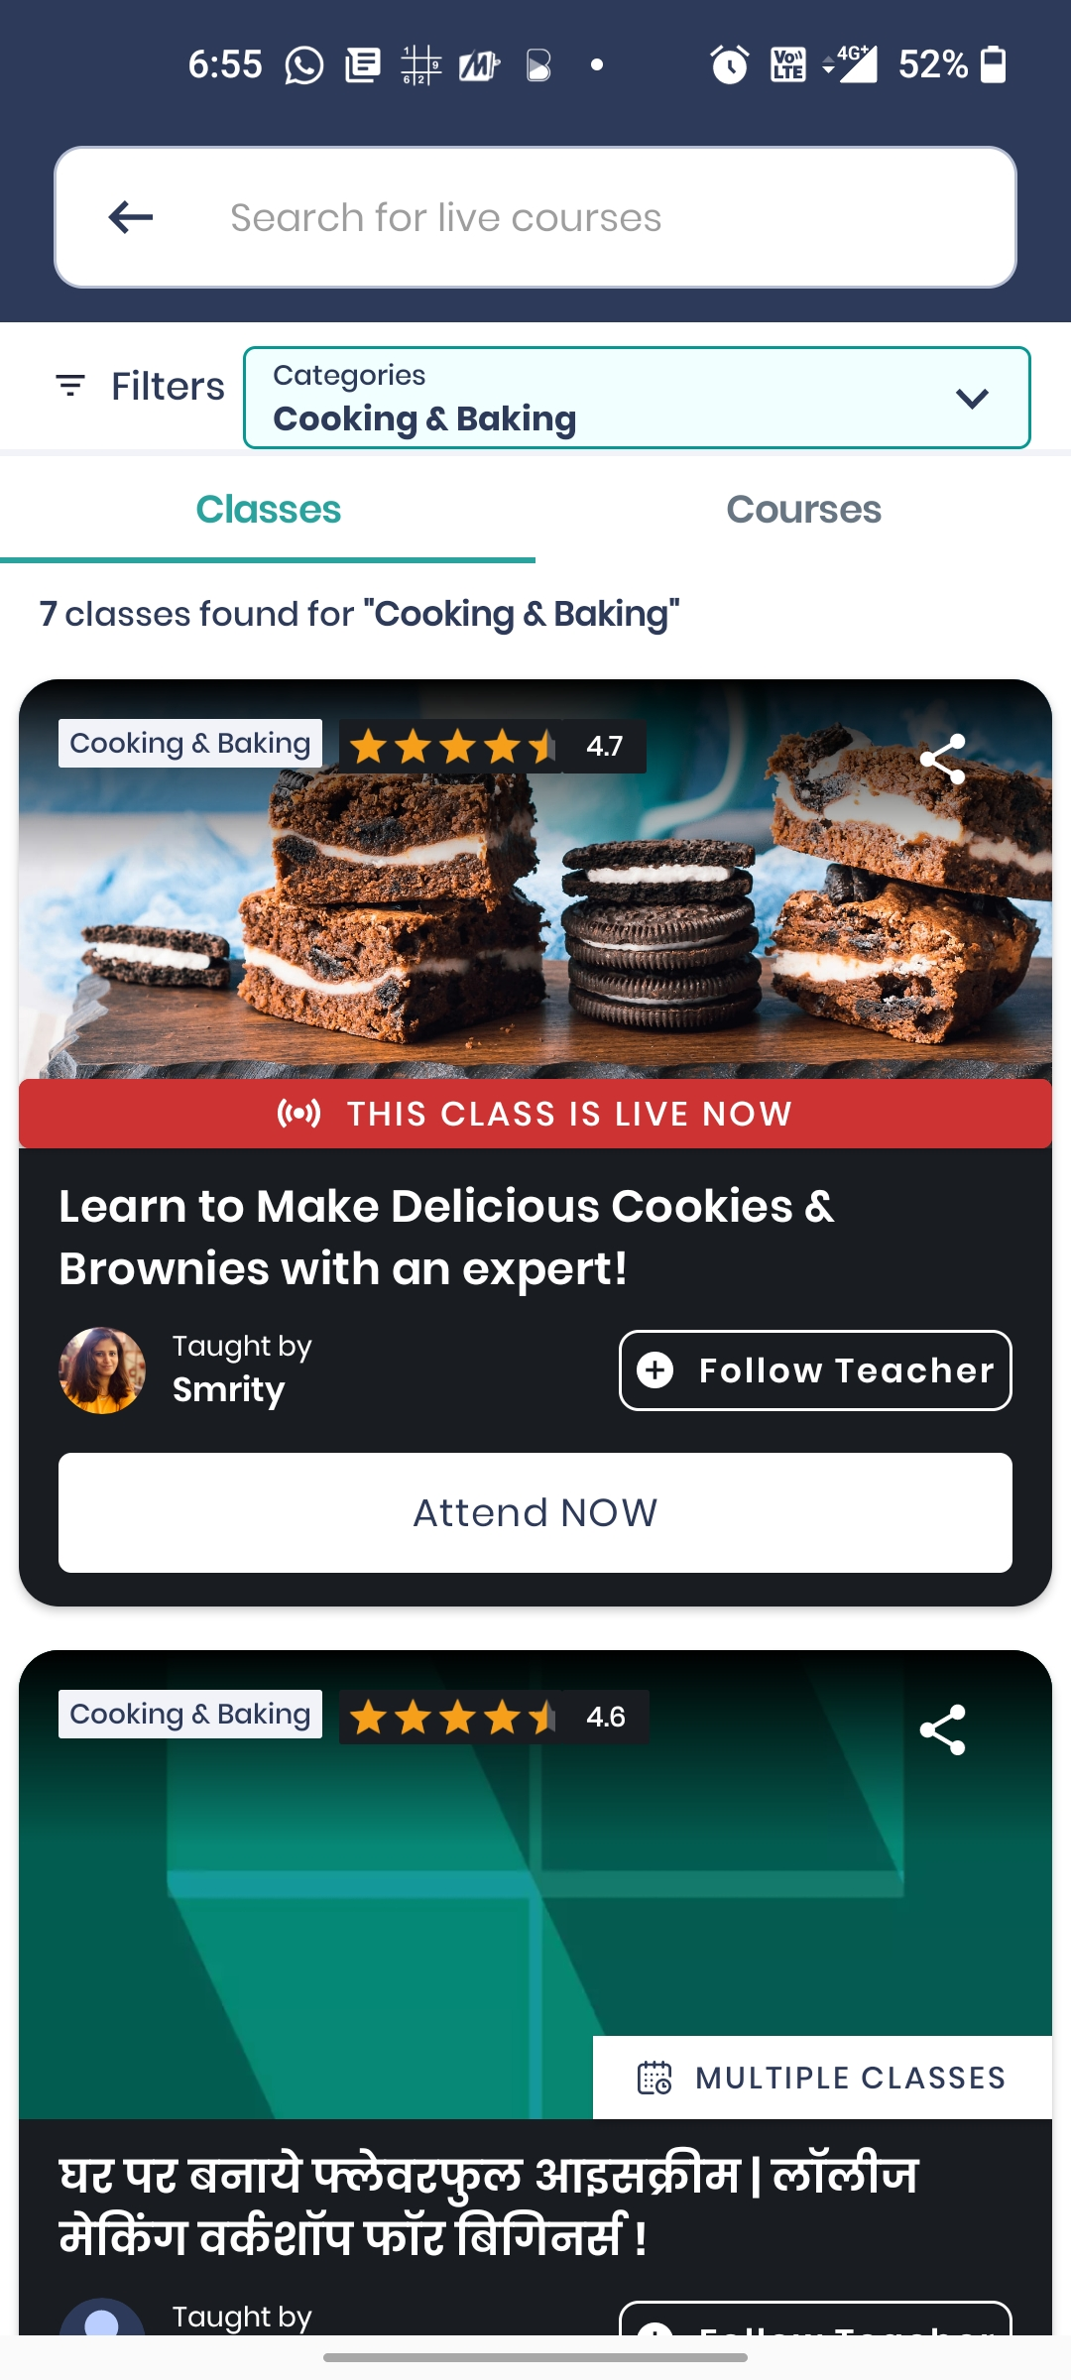
Explore
Description
Popup – What do you like to explore?
If a new user has scrolled till bottom and didn’t saw anything, then personalized recommendations should appear on the basis of his/her interest
What do you like to explore now?
Technology
Cooking
Dancing
Benefits
Improve the user-activation
Drive more traffic
Engage customers
Provide relevant material

Slide 20
Why are you going?
Description
Popup – Why are you going?
If user presses exit button then the above popup will appear with a list of reasons to understand the bounce-off reason of the user
After understanding the reason, a personalized push email can be sent
Hi Lisa,
Amazing new Cooking videos with delicious recipes are added to BitClass. Come have a look!
Why are you going?
Video content was not good
Unable to find video’s of your interest
Problem with Tutor
Others
Benefits
Improve the user-activation
Drive more traffic
Will make the new users attend one LIVE class or watch recorded videos

Slide 21
Solution Prioritization(BACER Framework)
Theme | Business Impact (B) | Customer Adoption (A) | Customer value (C) | Probability of Desired Result (R) | Engineering Effort (in person weeks) | Score (S) = (B*A*C*R)/E | Cardinal Rank (CR)
In-application Chatbot | 7 | 8 | 8 | 0.7 | 5 | 62.72 | 5
Incentive based learning | 8 | 9 | 10 | 0.85 | 7 | 87.42 | 3
Provide Market relevant content | 7 | 6.5 | 7 | 0.65 | 3 | 69.01 | 4
‘What’s your interest?’ popup | 9 | 9 | 9 | 0.9 | 3 | 218.7 | 1
‘Explore More’ popup | 8 | 9 | 9 | 0.85 | 3 | 183.6 | 2
LIVE Discussion Forum | 8 | 8 | 8 | 0.7 | 8 | 44.8 | 7
‘Why are you going?’ popup | 7 | 7 | 7 | 0.7 | 5 | 48.02 | 6

Slide 22
Thank you

